Slide 1

Superstore Marketing Campaign

Slide 2

Background and Context
The superstore is gearing up for its year-end sale and introducing an enticing new offer - the Gold Membership. This exclusive membership grants existing customers a 20% discount on all purchases for just $499, down from the regular $999. To promote this offer, a targeted campaign via phone calls to existing customers will be executed. Management seeks to develop a predictive model to classify customers based on their likelihood of purchasing the Gold Membership. This will optimize resource allocation and minimize unnecessary expenses by targeting those most likely to participate.
Notes:
Looking into Background and Context The superstore has launched a new Gold Membership offer, providing a 20% discount on all purchases for just $499, down from $999. They're conducting a targeted phone campaign for existing customers to promote this offer

Slide 3
Objective
The superstore wants to predict the likelihood of the customer giving a positive response and wants to identify the different factors which affect the customer's response. The data provided is used to identify these factors and then build a prediction model to predict the probability of a customer who gives a positive response.
Notes:
Our objective is to develop a predictive model to classify customers based on their likelihood of purchasing the Gold Membership. This will optimize resource allocation and target the most promising customers, minimizing unnecessary expenses. We aim to predict the likelihood of customers giving a positive response to this offer

Slide 4
Overview of the Dataset
2,224 data points and 22 Features
Identifiers ID : Unique ID of each customer
Independent Variables Demographics Amount spent No of purchases Recency Number of web visits Income
Target Response
Notes:
Demographics: Age, education, marital status, kid home, teen home, Our target variable is customer response, categorized as positive or negative. We'll conduct exploratory data analysis and feature engineering to prepare the data for modeling, aiming to build an accurate predictive model. Let's dive into our analysis and insights supported

Slide 5




Exploratory Data Analysis
Data Cleaning:
Created new features like total purchase amount and total number of purchases
Dropped unnecessary columns identified through data visualization
Feature Engineering:
Removed features correlated with most others
Converted year of birth to age for better interpretation
Created dummy variables for categorical features
Data Preprocessing:
Removed outliers from features
Scaled the data for logistic regression modeling
Notes:
Post univariate analysis along with data visualizations, we have performed the following steps.

Slide 6
Exploratory Data Analysis - Notable Results
The overall membership rate stands at 15%, indicating a moderate level of participation in the membership program.
Those who opted for membership exhibit a lower average recency of 35 days compared to non-members, who have an average recency of 51 days.
Customers with a PhD degree show a higher proportion of Gold membership status, suggesting a potential correlation between PhD and membership tier.
Only a minimal 1% of customers have lodged complaints, reflecting a generally satisfactory experience.
Higher avg. purchase ($50) offsets long recency (49 days) - Focus on increasing order value.

Slide 7

Methods - Model Evaluation Criteria
Error Types
False Positive: Predicting a customer for the membership who doesn't join. False Negative: Missing a potential member.
Maximizing Recall
Prioritize high Recall to excel at identifying True Positives (customers likely to join) – the true target audience for membership, thus reducing the loss from False Negatives.
This enables the superstore to focus its marketing efforts and resources on the customers with the highest potential for conversion.

Slide 8
Methods: Models Implemented
Selected Models: Classification models predict categorical outcomes, making them ideal for binary or multiple possibilities. With our binary target variable "response," we choose the best models for our data.
Logistic Regression: Ideal for binary classification, using the sigmoid function to predict the probability of an event y given input features x as P(y) = 1 / (1 + exp(-x)).
Ensemble Model: Utilizing logistic regression, KNN, and SVC, this approach combines models to improve accuracy. Logistic Regression: Identifies linear relationships. KNN: Recognizes similar patterns based on past behavior. SVC: Defines clear boundaries between responses.

Slide 9
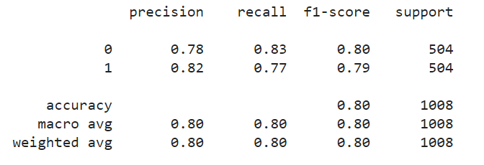
Results - LOGISTIC REGRESSION
Precision-recall analysis yielded a 0.575 threshold for optimal class identification.
Achieved 80% accuracy on both test and training data, indicating good overall model generalizability.
The precision for class 0 is 0.83, and for class 1 is 0.81.
Achieved a high recall values for both the classes on training data. The recall for class 0 is 0.83, and for class 1 is 0.77.
Notes:
Logistic regression has identified 424 records out off 504, with a recall of 77%.

Slide 10
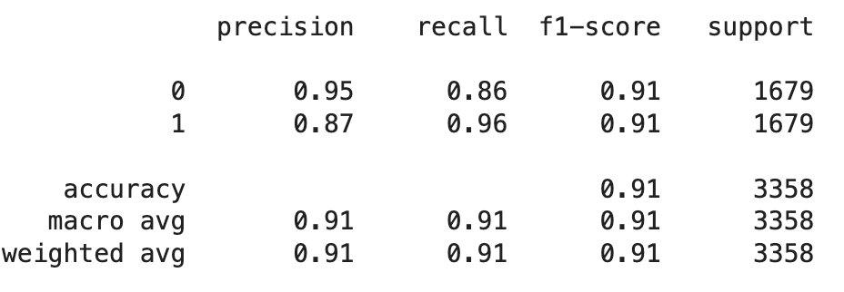
Results -Ensemble Model
Grid search analysis yielded 2 as the optimal Neighbours for class identification.
Achieved 91% accuracy on training data.
Excellent recall, especially for potential responders (96%).
Outperforms baseline model, demonstrating its effectiveness in predicting customer response.
Notes:
Out of 1679 model identified 1590 records with 95% recall.

Slide 11

Conclusions
Successfully predicted customer response likelihood and identified influential factors.
Ensemble model achieved impressive results (95% recall, 91% F1-score) compared to Logistic Regression.
Hyperparameter tuning and oversampling techniques boosted model's ability to forecast positive responses.
Enables targeted gold membership offers and personalized marketing campaigns.
Drives business growth through improved customer targeting and engagement.

Slide 12
Recommendations
Adjust the gap between recency and overall spending by upselling
They need to address the highly important but negatively correlated "teen home" feature
They can capitalize on the high importance "web visits per month" feature to drive even greater online traffic
Notes:
1 avg recency is 49 ~ which is not bad. They need to make the intended customer buy more. compared to market standard of 100$ the average order value is pretty low at 50$
2 high feature importance and negative correlation. Need to cater for teens or family size. Family wide discounts
3 Develop a robust social media strategy to increase brand awareness and website engagement.

Slide 13
Thank You !

